Slide 1
(Generative) Open-domain Question Answering
Seminar: Neural networks and artificial intelligence
Tahar Chettaoui B.Sc.
Supervisor: Fabian Retkowski M.Sc.

Slide 2
Outline
Introduction
Web Search Engines
QA Types
State of the art
Traditional OpenQA
Retriever-Reader
End-to-end Approaches
Retrieval-Augmented Language Model Pre-Training (REALM)
Retrieval-Augmented Generation (RAG)
Dense Passage Retrieval (DPR)
Bidirectional and Auto-Regressive Transformers (BART)
Experiments and Results
Summary

Slide 3
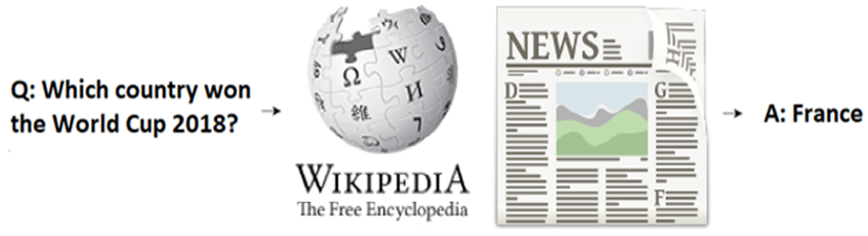

Question Answering (QA)
Automatically answer questions posed by humans in a natural language
Fig. 1: Question answering(QA) pipeline¹
1. A user enters a query into the system
2. System find the best match of the query in the database
3. The results returned may or may not match the query

Slide 4
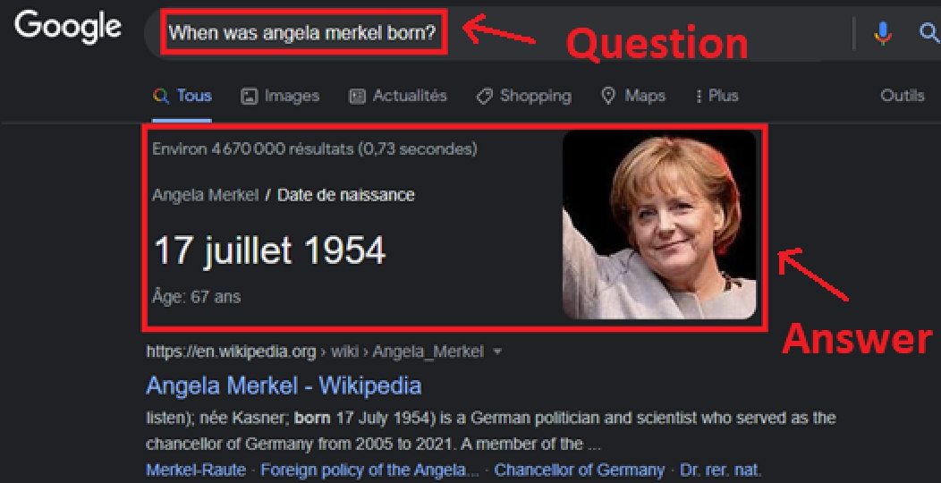
Web Search Engines
The QA system presents the final answer to a question directly instead of returning a list of relevant hyperlinks
Web search engines like Google and Bing are incorporating QA techniques into their search functionalities
Fig. 2: Google’s QA functionality

Slide 5
QA Types
According to the source of information, we can separate the QA systems in two:
1. Knowledge Base QA
Predefined structured database
2. Textual QA
Unstructured text documents.
Based on the availability of the context
2.1. Machine Reading Comprehension (MRC)
2.2. Open-domain QA (OpenQA)
➔ OpenQA answer a question in natural language based on large-scale unstructured world knowledge.

Slide 6
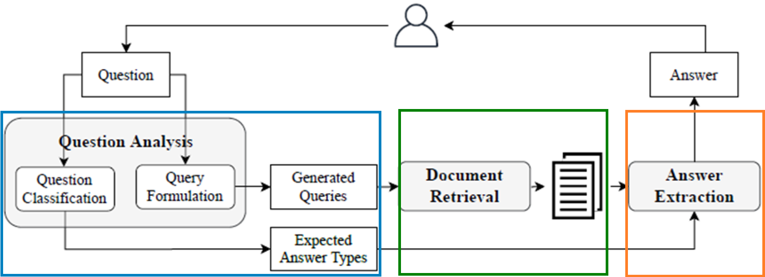
Traditional OpenQA
Traditional OpenQA systems follow a pipeline consisting of 3 stages:
Fig. 3: Traditional architecture of OpenQA systems¹

Slide 7
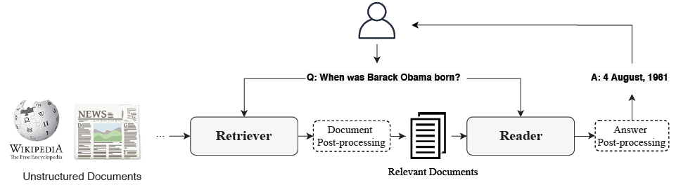
Retriever-Reader OpenQA
Retriever is aimed at retrieving relevant documents.
Reader aims at inferring the final answer from the received documents.
Fig. 4: Retriever-Reader architecture of OpenQA systems¹

Slide 8

End-to-end approaches - Pre-trained Language models
Models that assign probabilities to sequences of words are called language models:
Language models learn linguistic knowledge
They tend to store relational knowledge present in the training data
➔ The goal of language-model pre-training is to learn useful representations of language

Slide 9
End-to-end approaches - BERT and T5
Models such as BERT ² and T5 ³ store a surprising amount of world knowledge, acquired from the training.
BERT can correctly predict the missing word in the following sentence⁴:
Problems:
The learned world knowledge are stored implicitly in the parameters
The storage space is limited by the size of the network
“The ____ is the currency of the United Kingdom”
Answer: pound

Slide 10
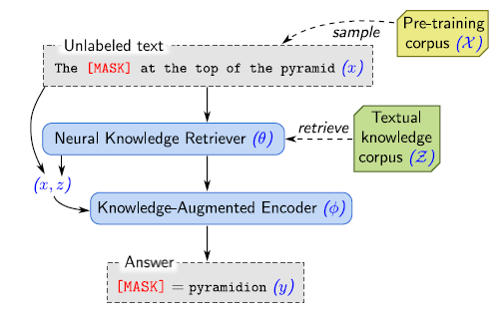

Retrieval-Augmented Language Model Pre-Training (REALM)
REALM is a pre-trained masked language model⁴
It is composed of a neural Retriever and a neural Reader
The system is able to compute the gradient w.r.t. the model parameters and backpropagate the gradient throughout all the network
.
Fig. 5: REALM unsupervised pre-training⁴

Slide 11
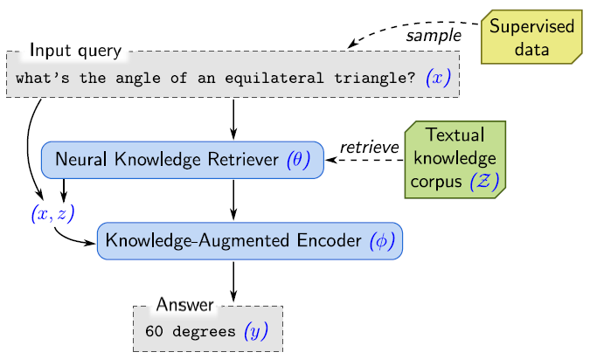
REALM fine-tuning
After the parameters of the retriever and encoder have been pre-trained
Using supervised examples, the parameters are then fine-tuned on OpenQA tasks.
Fig. 6: REALM Supervised fine-tuning⁴

Slide 12
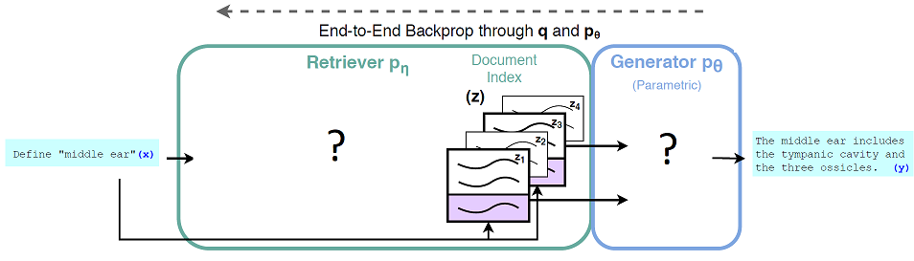
Retrieval-Augmented Generation (RAG)
RAG⁷ combinines a parametric and non-parametric memory to solve OpenQA
RAG adopts a generator as its reader that takes the input question as well as the best K documents chosen by the retriever
Fig. 8: RAG coarse view on the architecture

Slide 13
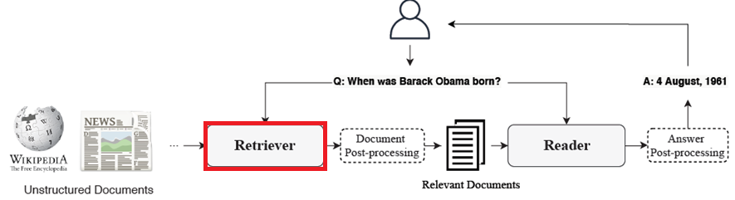
Dense Passage Retrieval (DPR)
This paper⁶ focus on improving the retrieval component in open-domain QA.
Goal of DPR is to index all the passages M in a low-dimensional space, then retrieve efficiently the top K passages relevant to question
M can be very large (21 million) and K is usually small(20–100).
Fig. 9: Retriever-Reader architecture of the OpenQA system

Slide 14
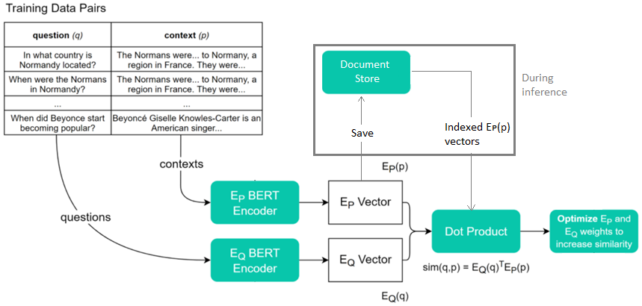
Dense Passage Retrieval (DPR) - Architecture
Fig. 10: DPR training pipeline⁹

Slide 15
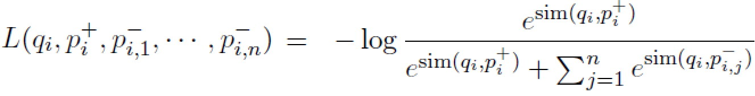

Dense Passage Retrieval (DPR) - Training
Training data:
q_{i} : question
P_{i}⁺ : positive passage (contains the answer)
P_{i,j}⁻ : negative passages
Loss function defined as the negative log likelihood of the positive passage:

Slide 16
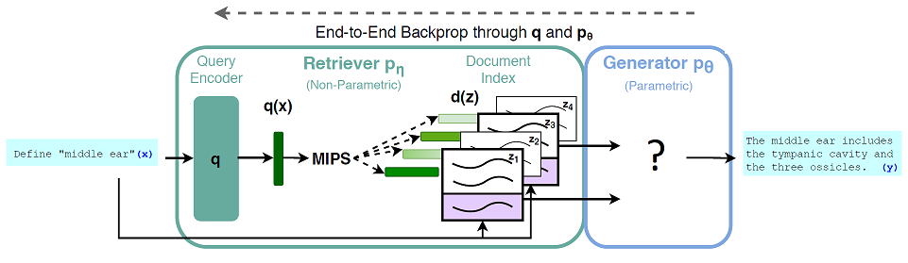
Retrieval-Augmented Generation (RAG)
DPR plays the role of the retriever in the RAG architecture
Fig. 11: RAG architecture, with focus on the retriever⁷

Slide 17
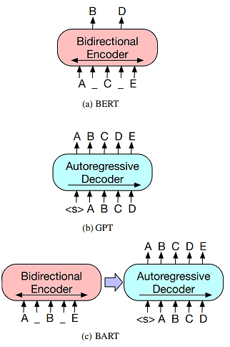
Bidirectional and Auto-Regressive Transformers (BART)
The Bidirectional and Auto-Regressive Transformer or BART¹⁰ combines a Bidirectional Encoder (i.e. BERT²) with an Autoregressive decoder (i.e. GPT¹¹) into one Seq2Seq model.
BART is a denoising autoencoder that maps a corrupted document to the original document it was derived from
Fig. 12: Architectures of (a) BERT; (b) GPT; (c) BART¹⁰

Slide 18

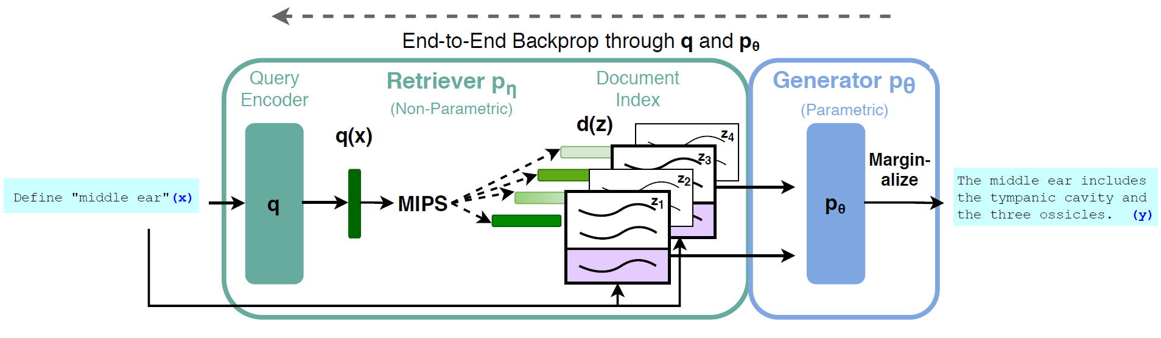
Retrieval-Augmented Generation (RAG)
We jointly train the retriever and generator components by minimizing the negative marginal log-likelihood of each target:
RAG-Sequence Vs. RAG-Token
Fig. 13: RAG complete training pipeline⁷

Slide 19
Experiments
Model | NQ | TQA | WQ | CT
REALM | 40.4 | - / - | 40.7 | 46.8
DPR | 41.5 | 57.9 / - | 41.1 | 50.6
RAG-Token | 44.1 | 55.2 / 66.1 | 45.5 | 50.0
RAG-seq | 44.5 | 56.8 / 68.0 | 45.2 | 52.2
Table 1: Open-Domain QA Test Scores.⁷

Slide 20
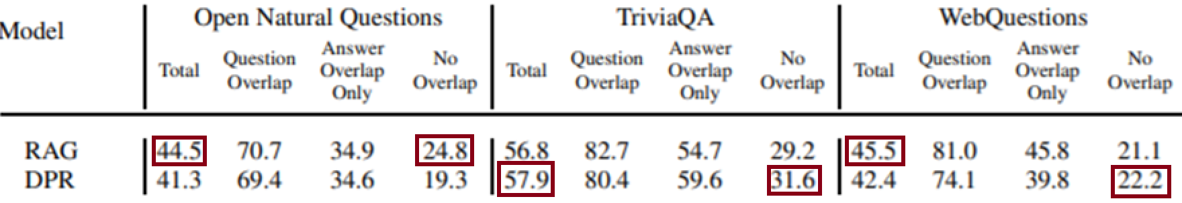
Experiments
There is a significant overlap between questions in the train and test sets in several public QA datasets⁸.
➔ 58-71% of test-time answers are also present somewhere in the training sets.
Table 2: Open-Domain QA Test Scores.⁸

Slide 21
RAG Advantages
Documents with clues about the answer but do not contain the exact answer can still contribute towards a correct answer
When the correct answer is not in any retrieved document, it is achieving 11.8% accuracy in such cases for NQ, where an extractive model would score 0%.

Slide 22
Summary
Goal of QA
QA Types
QA approaches
Traditional OpenQA
Retriever-Reader Architecture
End-to-end Approaches
REALM
Retrieval-Augmented Generation (RAG)
Dense Passage Retrieval(DPR)
Bidirectional and Auto-Regressive Transformers (BART)
Experiments & Results

Slide 23
References (1)
[1] Zhu, F., Lei, W., Wang, C., Zheng, J., Poria, S., & Chua, T. S. (2021). Retrieving and reading: A comprehensive survey on open-domain question answering. arXiv preprint arXiv:2101.00774.
[2] Devlin, J., Chang, M. W., Lee, K., & Toutanova, K. (2018). Bert: Pre-training of deep bidirectional transformers for language understanding. arXiv preprint arXiv:1810.04805.
[3] Raffel, C., Shazeer, N., Roberts, A., Lee, K., Narang, S., Matena, M., ... & Liu, P. J. (2019). Exploring the limits of transfer learning with a unified text-to-text transformer. arXiv preprint arXiv:1910.10683.
[4] Guu, K., Lee, K., Tung, Z., Pasupat, P., & Chang, M. W. (2020). Realm: Retrieval-augmented language model pre-training. arXiv preprint arXiv:2002.08909.
[5] Lee, K., Chang, M. W., & Toutanova, K. (2019). Latent retrieval for weakly supervised open domain question answering. arXiv preprint arXiv:1906.00300.

Slide 24
References (2)
[6] Karpukhin, V., Oğuz, B., Min, S., Lewis, P., Wu, L., Edunov, S., ... & Yih, W. T. (2020). Dense passage retrieval for open-domain question answering. arXiv preprint arXiv:2004.04906.
[7] Lewis, P., Perez, E., Piktus, A., Petroni, F., Karpukhin, V., Goyal, N., ... & Kiela, D. (2020). Retrieval-augmented generation for knowledge-intensive nlp tasks. arXiv preprint arXiv:2005.11401.
[8] Lewis, P., Stenetorp, P., & Riedel, S. (2020). Question and answer test-train overlap in open-domain question answering datasets. arXiv preprint arXiv:2008.02637.
[9] James Briggs, https://towardsdatascience.com/how-to-create-an-answer-from-a-question-with-dpr-d76e29cc5d60
[10] Lewis, M., Liu, Y., Goyal, N., Ghazvininejad, M., Mohamed, A., Levy, O., ... & Zettlemoyer, L. (2019). Bart: Denoising sequence-to-sequence pre-training for natural language generation, translation, and comprehension. arXiv preprint arXiv:1910.13461.

Slide 25
References (3)
[11] Alec Radford, Karthik Narasimhan, Tim Salimans, and Ilya Sutskever. Improving language understanding by generative pre-training. URL https://s3-us-west-2. amazonaws. com/openaiassets/researchcovers/languageunsupervised/language understanding paper. pdf, 2018.

